Slide 1
Module -3 Statistical Experiment and Significance Testing
Prof. Sarala Mary

Slide 2
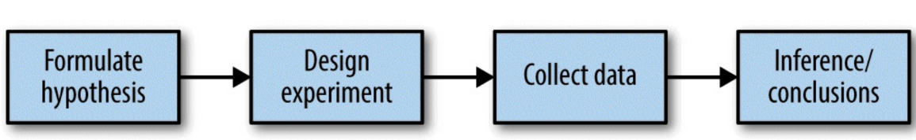
Classical Statistics Inference Pipeline

Slide 3
A/B Testing
An A/B test is an experiment with two groups to establish which of two treatments, products, procedures, or the like is superior.
Treatments - be the design of web page, the price of a product, the wording of a headline, or some other item.
Subject - Subject in the experiment is the web visitor,
Outcome - measuring are clicks, purchases, visit duration, number of pages visited, whether a particular page is visited etc.

Slide 4
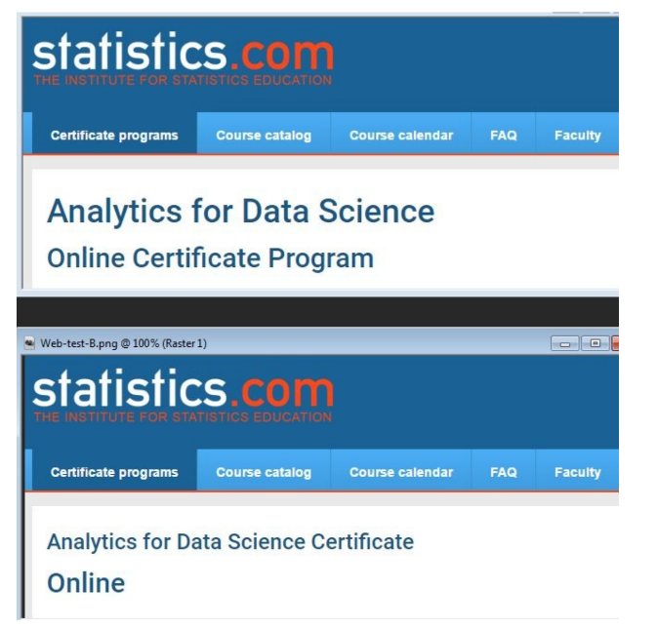
Example:

Slide 5
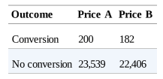

Example

Slide 6
Hypothesis Test
A statistical hypothesis test is further analysis of an A/B test, or any randomized experiment, to assess whether random chance is a reasonable explanation for the observed difference between groups A and B.

